Slide 1
Developing a Positive School Climate to Prevent Incidents
August 2018

Slide 2
Today’s Topics
School Safety in NYS: laws and regulations
Implementation of the Dignity for All Students Act (DASA)
School Safety and the Educational Climate (SSEC) Reporting
Overview of School Climate: How Positive Climate Can Prevent Incidents

Slide 3
Technical vs. Adaptive Solutions
Technical Solutions
Adaptive Solutions
Fixing or improving the current system
Involve processes and procedures
Use solutions that have worked for similar problems
Usually a relatively quick fix
Bring order and predictability
Changing hearts and minds
Involve people’s needs and interactions
Require new and different ideas
Require ongoing attention and analysis
Challenges the Status Quo

Slide 4

Leadership
“The most common cause
of failure in leadership is produced by treating
adaptive challenges as if
they were technical
problems,”
Ron Heifetz The Practice of Adaptive Leadership

Slide 5
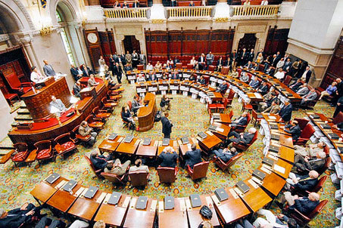
Project SAVE Law
Passed into law 2000
Education Law Section 807 and 2801-a
Commissioner’s Regulations 155.17

Slide 6
Safe Schools Against Violence in Education Act (SAVE) - Project SAVE
Purpose:
prevent or minimize the effects of violent incidents and emergencies
facilitate the coordination of schools and school districts with local and county resources in the event of such incidents or emergencies.
Quick Guide to Emergency Response Planning http://docs.wixstatic.com/ugd/10c789_731f37d8b971468f8f133160c435279e.pdf

Slide 7
Project SAVE: Overview
Quick Guide to Emergency Response Planning
Requirements in Education Law §§2801-a,
and Commissioner’s Regulation 155.17
Teams Required | Plans Required
District-wide School Safety Team Building Level Emergency Response Team Emergency Response Team Post-incident Response Team | District Wide Safety Plan Building Level Emergency Response Plan

Slide 8
Project SAVE: District Wide vs. Building Level Plans
District Wide School Safety Plans
Comprehensive broad concepts, policies and procedures
Outline strategies rather than provide details
Focuses on district policy
Includes DASA and Code of Conduct requirements
Open for public review
Building Level Emergency Response Plans
Detail specific response strategies
Show how school personnel and students respond in their building to an emergency
Details about evacuation and where students reassemble
Information specific to emergency communication between staff, responders and family
Confidential; are protected from disclosure
https://safeschools.ny.gov/differences-between-district-wide-and-building-level-plans

Slide 9
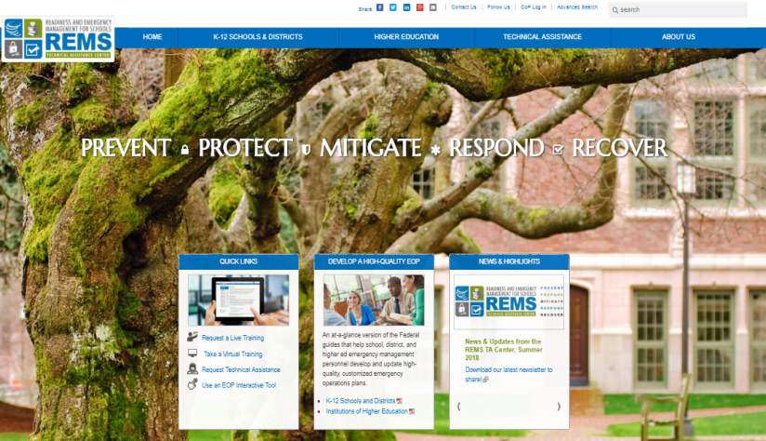
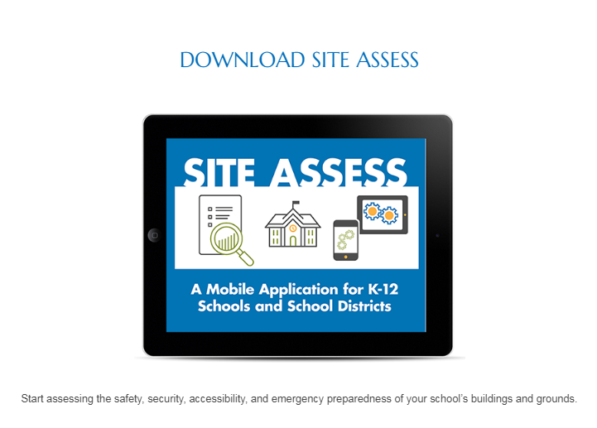
Project SAVE Resources for Professional Development
Readiness Emergency Management for Schools
(REMS) TA Center
https://rems.ed.gov/
https://rems.ed.gov/default.aspx
REMS TA Center: Site Assess App for Schools
https://rems.ed.gov/default.aspx

Slide 10

Project SAVE Resources for Professional Development
Federal Emergency Management Agency (FEMA)
https://www.fema.gov/media-library/assets/documents/25975

Slide 11

Project SAVE Resources for Professional Development
Multi-Hazard Emergency Planning for Schools
October 16- 18
Westchester County
Southern Westchester BOCES
2018- 2019 training schedule currently being developed
Subscribe to NYSCFSS website

Slide 12
Project SAVE Resources for Implementation
NYSED Website
http://www.p12.nysed.gov/sss/ssae/schoolsafety/save/
New York’s Safe Schools
https://safeschools.ny.gov/

Slide 13
Implementation Resources REMS TA Center Protocols
Violent intruder tabletop exercise: https://rems.ed.gov/docs/repository/REMS_000048_0001.pdf
Lockdown drill observation form:
https://rems.ed.gov/docs/2017Toolbox/NJ_Lockdown%20Drill.pdf
Lockdown drill checklist:
https://rems.ed.gov/docs/repository/REMS_000067_0002.doc
Bus crash tabletop exercise
https://rems.ed.gov/docs/2017Toolbox/IA_Bus%20Crash%20Tabletop.pdf
If you have developed a protocol for your school, you can share with others by uploading to REMS TA center website
https://rems.ed.gov/ToolBox.aspx

Slide 14

Project SAVE
What was new information?
What are you already doing?
What is one next step for your district/school?

Slide 15

Dignity for All Students Act

Slide 16
NYS Dignity for All Students Act (DASA)
Legislative Intent: “… To afford all students in public schools an environment free of discrimination and harassment.
The purpose of this … is to foster civility in public schools and to prevent and prohibit conduct which is inconsistent with a school’s educational mission.”
Ed. Law Article 2 Section 10
Notes:
The legislature finds that students’ ability to learn and to meet high academic standards, and a school’s ability to educate its students, are compromised by incidents of discrimination or harassment including bullying, taunting or intimidation. It is hereby declared to be the policy of the state to afford all students in public schools an environment that is free of discrimination and harassment.

Slide 17
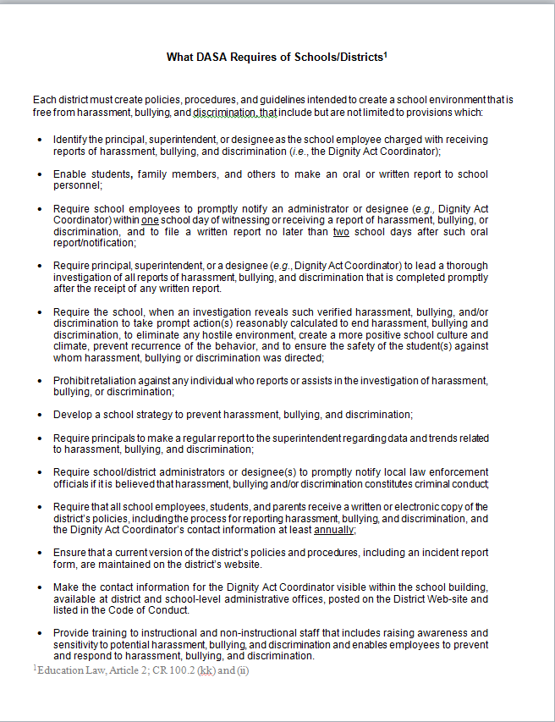

What DASA Requires of Schools
Notes:
Source? Reference?

Slide 18

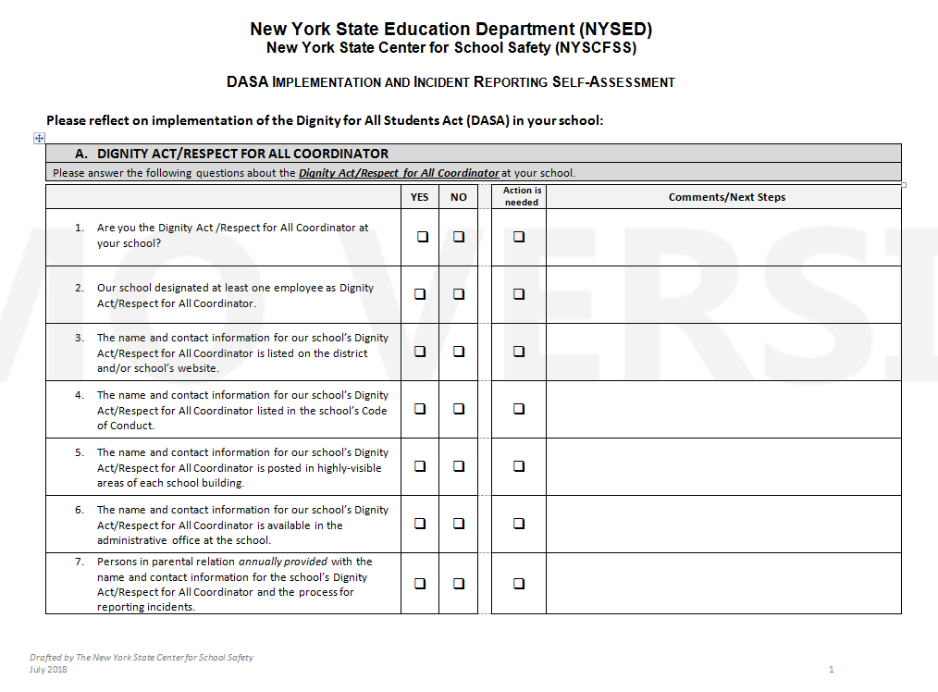
DASA Self Assessment

Slide 19

Dignity Act Coordinator Poster
Click on Document for link

Slide 20

New for 2018 Amendment CR 100.2 kk
illustrative examples
gender includes gender identity and/or expression.
Examples:
access to school facilities,
application of dress code
use of name(s) and pronoun(s)
Effective May 2018

Slide 21

Correcting Misconceptions
DASA does not apply only to the protected categories; it applies to ALL STUDENTS
Bullying does not have to be repeated; it can be a SINGLE INCIDENT that has the potential to occur more than once

Slide 22
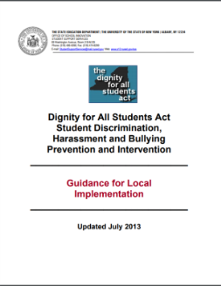
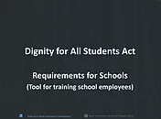

DASA Resources
Beginning
Advanced
SSEC DASA Implementation FAQ’s on NYSCFSS Web-site
http://www.nyscfss.org/dasa-implementation-faqs
DASA PowerPoint
Local Implementation Guidance
Best Practices
Click on Document for link
Click on Document for link
Click on Document for link

Slide 23
Responding to Incidents (RI)
Complaint Received
THOROUGH INVESTIGATION
REPORT TO SED
INCIDENT VERIFIED
DEVELOP STUDENT ACTION PLANS
DOCUMENTATION RETENTION
NOT VERIFIED

Slide 24
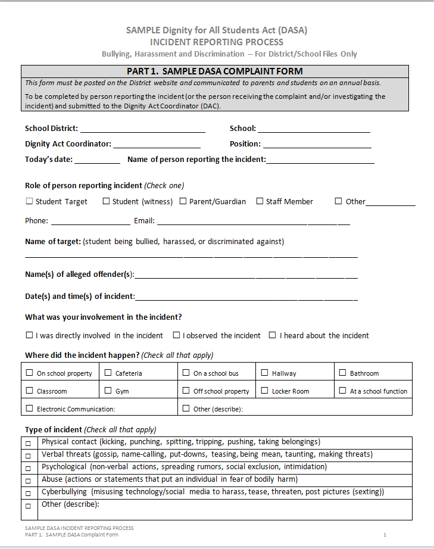
Complaint
Complaint Received
RI Form Part 1: Complaint Form

Slide 25
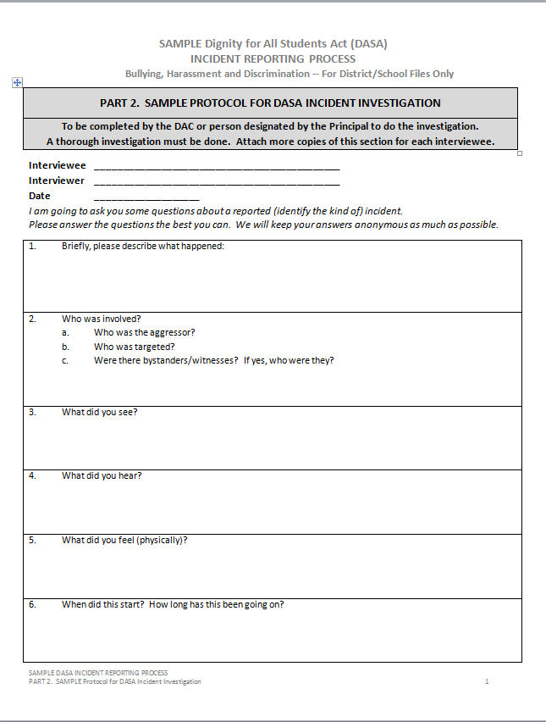
Investigation
THOROUGH INVESTIGATION by DAC and/or designee
RI Form Part 2: Investigation Protocol

Slide 26
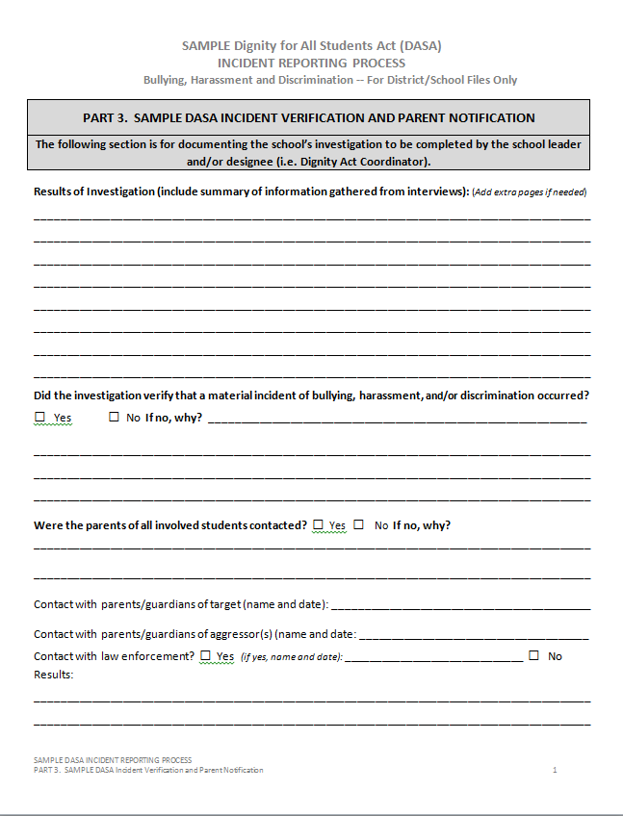
Verification
INCIDENT VERIFIED
RI Form Part 3: Incident Verification
Incident NOT VERIFIED; not reported to SED
(retain notes)

Slide 27
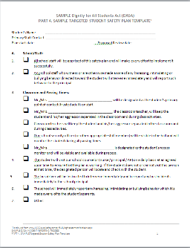
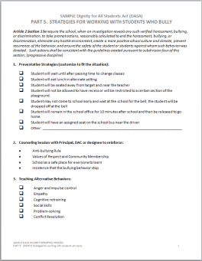
Plans
RI Form – Parts 4 & 5
DEVELOP Student Action PLANS
Part 4 – Student Action Plan for Target
Part 5 – Strategies for Working
With Students Who Bully

Slide 28
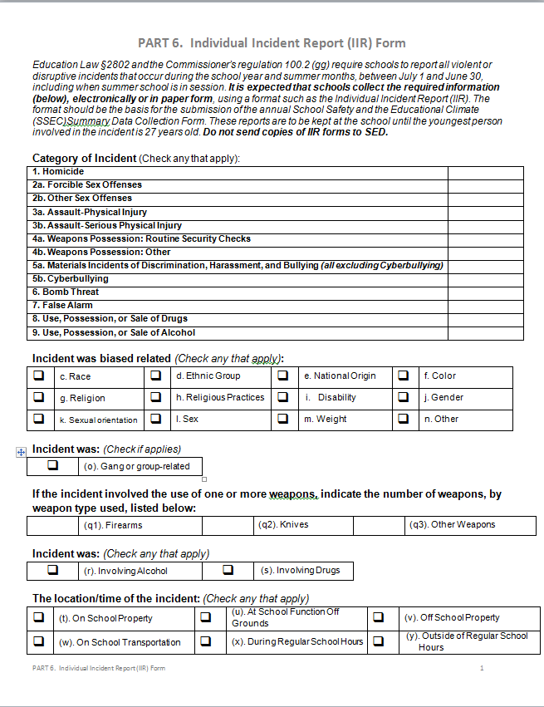

Reporting
REPORT TO SED
Record verified incidents on SSEC
Summary Data Collection Form
RI Form – Part 6: Individual Incident Report (IIR)
SSEC Summary Data Collection Form
Click image for link

Slide 29
Documentation Retention
DOCUMENTATION RETENTION
POST-REPORTING
Keep all of the Forms Stored Together
Forms stay at the school where the incident occurred.
Reports are to be kept until the youngest person involved is 27 years old.*
*Records Retention and Disposition Schedule ED-1

Slide 30

Professional Development Resource for SSEC Reporting

Slide 31
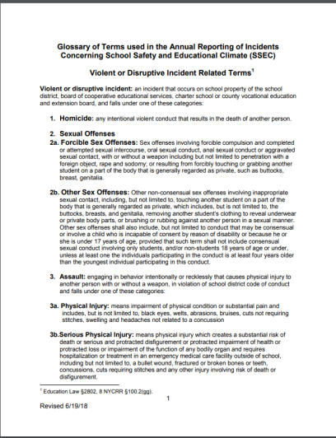
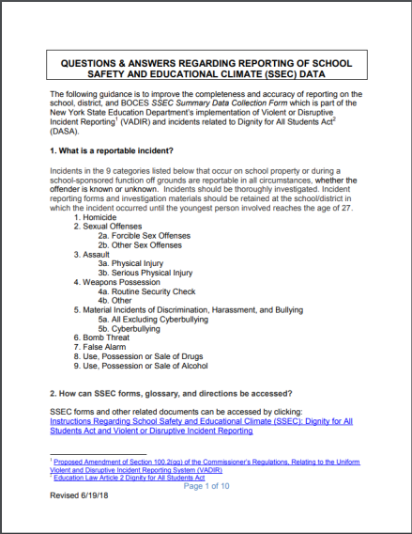
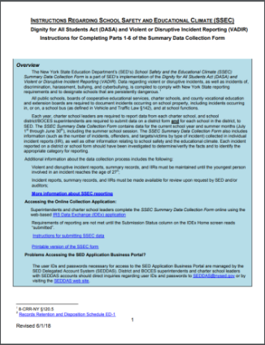
Resources for SSEC Reporting
Glossary
Q & A
SSEC Summary Data Collection Form
Instructions for SSEC Form
Click image for link
Click image for link
Click image for link
Click image for link

Slide 32


Using SSEC Data to Reduce Incidents

Slide 33
Using SSEC Data to Reduce Incidents
“Without data
you’re just
another person
with an opinion.”
W. Edwards Deming,
Data Scientist

Slide 34

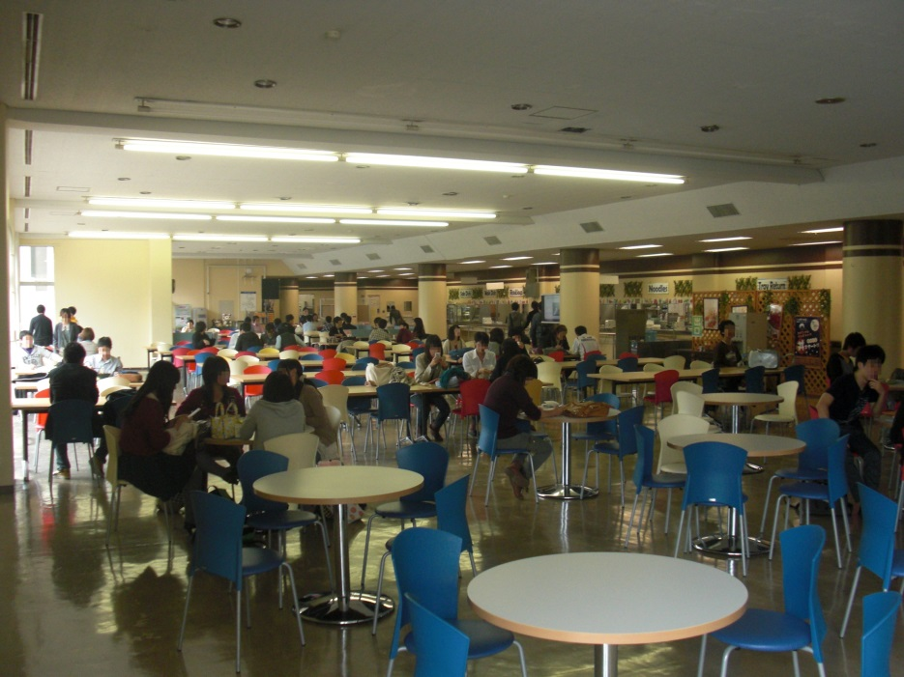
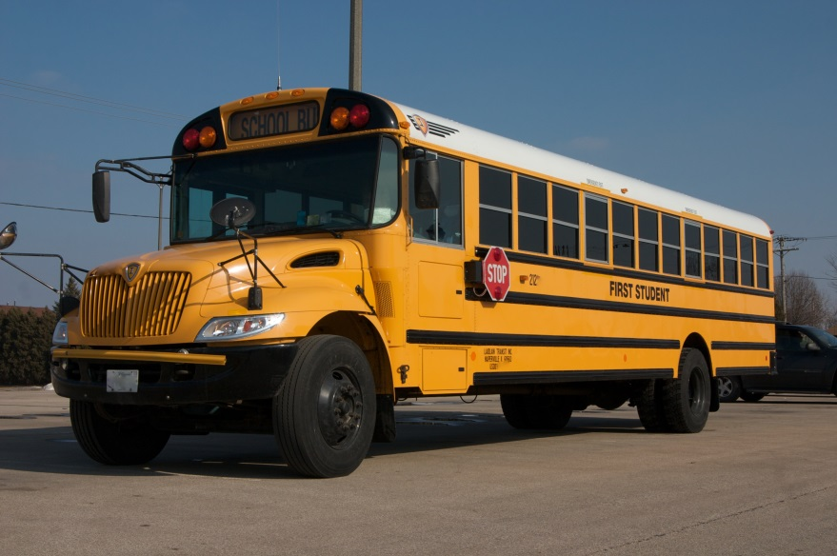
Scenarios

Slide 35
DASA and Preventing Incidents
Legislative Intent: “… To afford all students in public schools an environment free of discrimination and harassment. The purpose of this … is to foster civility in public schools and to prevent and prohibit conduct which is inconsistent with a school’s educational mission.”
Ed. Law Article 2 Section 10

Slide 36
How can DASA Implementation Prevent Incidents?
DASA Legislation
Require the school … to take prompt actions reasonably calculated to … create a more positive school culture and climate …
Include a school strategy to prevent harassment, bullying and discrimination
NYS Law Article 2 Chapter 13 1 (e) (g) https://www.lawserver.com/law/state/new-york/ny-laws/new_york_laws_education_title_1_article_2

Slide 37

School Climate
https://www.youtube.com/watch?v=VxyxywShewI

Slide 38
Domains of School Climate
Engagement: includes relationships, respect for diversity, and school participation
Safety: includes emotional and physical safety and reduction of substance abuse
Environment: includes the physical, academic, and disciplinary environments and wellness

Slide 39
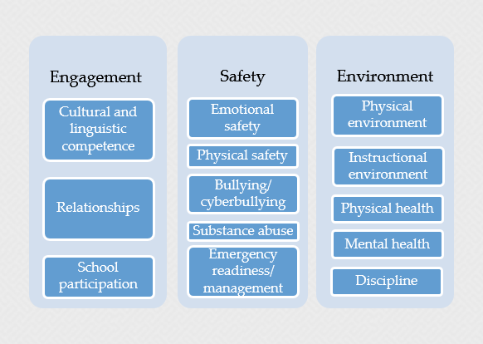
Domains of School Climate
US Department of Education (USDE)
School Climate Surveys
National Center on Safe Supportive Learning Environments https://safesupportivelearning.ed.gov/edscls/measures

Slide 40
Positive School Climate
Trusting and supportive relationships
A common set of goals and norms
A sense of collaboration and involvement
A sense of connection and engagement
Creating and Sustaining a Positive and Communal School Climate by Allison Ann Payne, PhD, National Institute of Justice Report, February 2018, https://www.ncjrs.gov/pdffiles1/nij/250209.pdf

Slide 41
A Positive School Climate
Increases
Decreases
Attendance
Achievement
Retention
Graduation Rates
Motivation to Learn
Psychological well-being
Teacher Retention
Absenteeism
Suspensions
Substance Abuse
Bullying
Negative effects of self-criticism and socioeconomic status on academic success
Teacher Burnout

Slide 42
Student Experiences that Contribute to Poor School Climate
Lack of connection
Lack of safety (physical, emotional, social)
Teasing, bullying, gangs
Negative relationships with adults and peers
Reactive punitive approaches to discipline

Slide 43

How can positive school climate prevent incidents?
Adults
support diversity
encourage communication
intervene in conflicts
work to prevent teasing and bullying
Enhancing School Safety Using a Threat Assessment Model An Operational Guide for Preventing Targeted School Violence, National Threat Assessment Center, July 2018, pg 19 https://www.secretservice.gov/data/protection/ntac/USSS_NTAC_Enhancing_School_Safety_Guide_7.11.18.pdf

Slide 44

How can positive school climate prevent incidents?
Students
feel empowered to share concerns with adults
without feeling ashamed or facing the stigma of being labeled a “snitch”
Enhancing School Safety Using a Threat Assessment Model An Operational Guide for Preventing Targeted School Violence, National Threat Assessment Center, July 2018, pg 19 https://www.secretservice.gov/data/protection/ntac/USSS_NTAC_Enhancing_School_Safety_Guide_7.11.18.pdf

Slide 45

What do you do when students report a potential incident?
Option: Multi-disciplinary Threat Assessment Team
assess the threat
intervene to keep students safe and
provide support to students who are threatening to harm others and/or themselves.
A Retrospective Study of School Safety Conditions in High Schools Using the Virginia Threat Assessment Guidelines Versus Alternative Approaches by D. Cornell, P. Sheras, A. Gregory and X. Fan, 2009 Vol 24, No. 2, 119-129 School Psychology Quarterly http://www15.uta.fi/arkisto/aktk/projects/sta/Cornell_Sheras_Gregory_Fan_2009_Retrospective-Study-of-School-Safety_Conditions-in-High-Schools.pdf

Slide 46

Impact of Threat Assessment Teams
Fewer Long-term Suspensions
Less bullying and student victimization
Greater willingness to seek help
More positive perceptions of school climate
A Retrospective Study of School Safety Conditions in High Schools Using the Virginia Threat Assessment Guidelines Versus Alternative Approaches by D. Cornell, P. Sheras, A. Gregory and X. Fan, 2009 Vol 24, No. 2, 119-129 School Psychology Quarterly http://www15.uta.fi/arkisto/aktk/projects/sta/Cornell_Sheras_Gregory_Fan_2009_Retrospective-Study-of-School-Safety_Conditions-in-High-Schools.pdf

Slide 47

Creating a Positive School Climate
Adaptive Change

Slide 48

Why Measure School Climate?
Provide Feedback
Opportunity for group
and individual reflection
ORID: Focused Conversation
Data Analysis
Data Interpretation Guide
from the USDoE
https://safesupportivelearning.ed.gov/edscls/data-interpretation

Slide 49
Using a Data Protocol
What results stood out? | Why? | What other data do you have? (behavior, attendance, academics, etc.) | Next steps
Encouraging:
Concerning:

Slide 50

Strategies for Creating a Supportive School Climate
Relationships

Slide 51

3 Questions for Changing School Climate
With your elbow partner
and a second elbow partner group
please discuss the question:
1. What are you already doing to create a positive school climate?

Slide 52
3 Questions for Changing School Climate
With your elbow partner
and a second elbow partner group
please discuss the question:
What is one additional thing you could do
to enhance school climate?

Slide 53
3 Questions for Changing School Climate
With your elbow partner
and a second elbow partner group
please discuss the question:
What is one thing that you would recommend that everyone do to improve school climate?

Slide 54
Strategies To Create a Positive School Climate
Engagement: includes relationships, respect for diversity, and school participation
Safety: includes emotional and physical safety and reduction of substance abuse
Environment: includes the physical, academic, and disciplinary environments and wellness

Slide 55
How do you respond to real life examples?
Form Groups of 4 – 5
1. group facilitator, 2. scribe, 3. spokesperson, and 4. timekeeper
Read example and write down initial response and share with the group
Groups discuss
What is the short-term response?
What is the long-term response?

Slide 56


Take-aways
One new idea
One thing you will do
back at your school

Slide 57
School Climate Survey Pilot Project
Introduce the NYSED climate survey pilot project
Solicit feedback/new ideas/success stories from any schools currently implementing climate surveys
Ask for any participants
For more information…

Slide 58

Thank you for participating

Slide 59
Contact Information
NYSED Student Support Services
518-486-6090
http://www.p12.nysed.gov/sss/
Questions regarding DASA and SSEC SSEC@nysed.gov
Questions regarding School Climate Surveys SchoolClimate@nysed.gov
New York State Center for School Safety
844-509-7161
www.nyscfss.org
@NYSCFSS

